Slide 1

Soil Carbon and Respiration
Aaron Korte, Favour Powei Etinkumoh, Gabrielle Nauta, Carla Ott, Gergely Istvan Toth
Ecosystem-Atmosphere Processes - WiSe 2023

Slide 2
Table of Content
Introduction
Model structure
Model assumptions
Model parameters and rate modifier
Our Model
Model Calibration
Model Validation and sensitivity analysis
Climate change scenarios
Possible improvements

Slide 3




Soil Carbon and Respiration: Introduction
Essential components of the carbon cycle
Balance between litter input and respiration loss
Input: Carbon
Different pools
CO₂ emissions depend on carbon stored in soils
Output: Respiration
Release of CO₂
Root respiration and microbial respiration
Notes:
Soil carbon and respiration are essential components of the carbon cycle, and play an important role in the cycling of carbon between the atmosphere, the plants, and the soil.
· Input: Soil carbon:
Soil carbon exists in different pools within the soil, and these pools represent different degrees of decomposition and turnover rates. Understanding these pools, as well as the inputs and the outputs, is important for assessing soil health, nutrient cycling, and the overall carbon balance in ecosystems, since the emission of CO2 from land ecosystems greatly depends on the amount of carbon stored in soils.

Slide 4

Soil Carbon and Respiration: Introduction
Essential components of the carbon cycle
Balance between litter input and respiration loss
Input: Carbon
Different pools
CO₂ emissions depend on carbon stored in soils
Output: Respiration
Release of CO₂
Root respiration and microbial respiration
Notes:
· Soil respiration:
Soil respiration is the process by which microorganisms metabolize organic matter, thereby releasing CO2 into the atmosphere. It consists of two main components:
o Root Respiration, which is the respiratory activity of plant roots, releasing CO2 as a byproduct of cellular respiration.
o Microbial Respiration, which is when microbes break down organic matter, using it as a source of energy and releasing CO2 in the process.
For our model we only focus on microbial respiration.
In summary, soils are carbon reservoirs, and modeling the processes of carbon translocation through the soil play a crucial role in understanding the breakdown of different types of organic matter. It helps us understand how carbon sequestration in diverse ecosystems responds to various climate conditions and management practices.

Slide 5
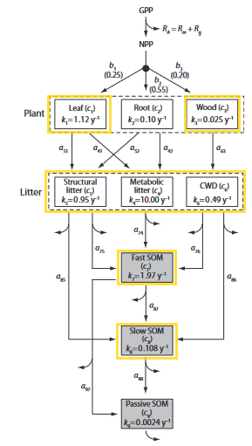
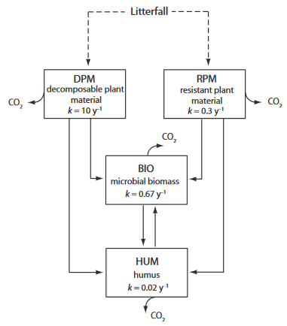
Initial model structure
RothC
CASA
Notes:
We started building our model according to templates from the literature.
Our first template was the RothC model, a process-based model originally developed to model the turnover of organic carbon in arable soils (Nemoto 2014). In this model, SOC is divided into 4 different organic matter pools. One advantage of the RothC model is lower requirements for input data, but forests, compared to arable lands, have more diverse litter layers and vegetation types, which may not be represented well by the simplified pool structure of the RothC model. Also, the parameters and decay rates for the RothC model, originally designed for agricultural lands, were not aligning with values for forest ecosystems from the literature.
Therefore, we decided to base our model on the CASA model. This model has a bigger number of pools, which makes it better suited to account for the vegetation dynamics of forest ecosystems.
CASA is a biogeochemical model. Carbon flows from donor to receiver pools at a rate that depends on the donor pool size. The rate of flow (the rate of decay) and the fraction (a) of matter that goes into the next pool depends on environmental conditions. This conceptualization leads to a system of first-order, linear differential equations to represent the plant, litter, and soil pools.
The carbon residence time varies among pools, from several months for leaves and roots to centuries for soil organic matter.

Slide 6
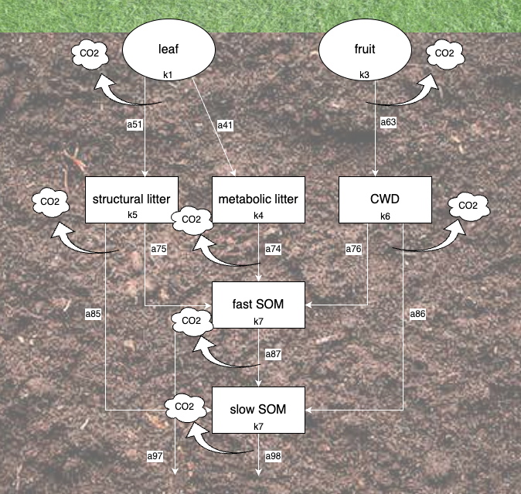
Own model structure
Notes:
The available data from the Hainich forest included two datasets, one for litterfall and one for fruitfall, over the years 2016 and 2017. Therefore, from the original three plant pools from the CASA model we decided to keep only two pools: the “leaf” and “wood” pools.
Based on an estimation of decay rates from the literature, we chose the “wood” pool from the CASA model to be best representative of our “fruit” pool. We chose to ignore the passive SOM pool, as it is relatively stable and inert.
Here, the leaves and fruits that fell on the ground decompose according to different rates, k1 and k3 (we kept the notation from the template model from the book). These decomposition rates depend on environmental factors such as temperature and moisture.
The dead plant material then enters the belowground pools according to a certain ratio, or fraction, “a”, and all incoming plant material passes through these different compartments once, and only once.
The “leaf” pool is partitioned into two different pools: structural litter and metabolic litter, due to different decomposition rates for different leaf components. The structural leaf pool represents the structural components of leaves, such as cellulose and lignin, and the metabolic leaf pool represents the labile compounds of leaves, such as sugars and starch. Cellulose and lignin are more resistant to decomposition than sugars and starch, and therefore the decay rate of the structural litter pool is lower than the decay rate for the metabolic litter pool.
The CASA model simplifies the decomposition dynamics associated with woody biomass, so our “fruit” pool, too, is simplified to represent only one pool, referred to as the “Coarse Woody Debris” pool.
The carbon in these three litter pools is then relocated to either the “Fast” or “Slow” SOM pools. The “fast” SOM consists of recently added plant residues and other easily decomposable organic material, and the “slow” SOM consists of organic matter that decomposes more slowly, contributing to longer-term carbon storage in the soil. The allocation of carbon between “fast” and “slow” SOM pools is influenced by the decomposition rates: if high, a larger proportion of carbon will be rapidly decomposed and released back into the atmosphere. On the other hand, if low, a greater portion of carbon will be retained in the slow SOM pool for a more extended period.
And all along the process of decomposition, microbes respire CO2.
That’s it for the background information on the structure of our model. I will now leave the stage to Aaron.

Slide 7

Model Assumptions
Leaf and fruit input limited to 20 days/year (7 to 27th of August)

Slide 8
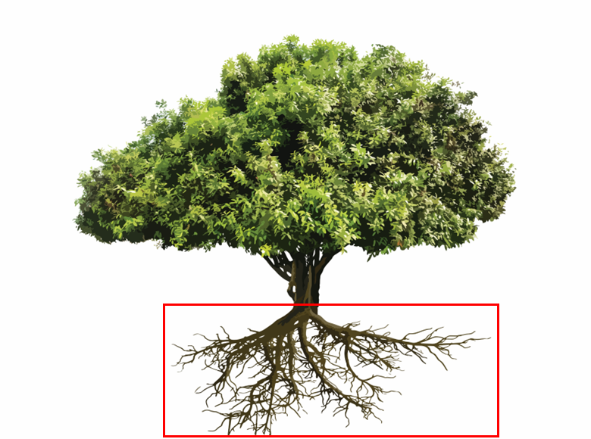
Model Assumptions
Only calculation of heterotrophic respiration during decomposition process

Slide 9
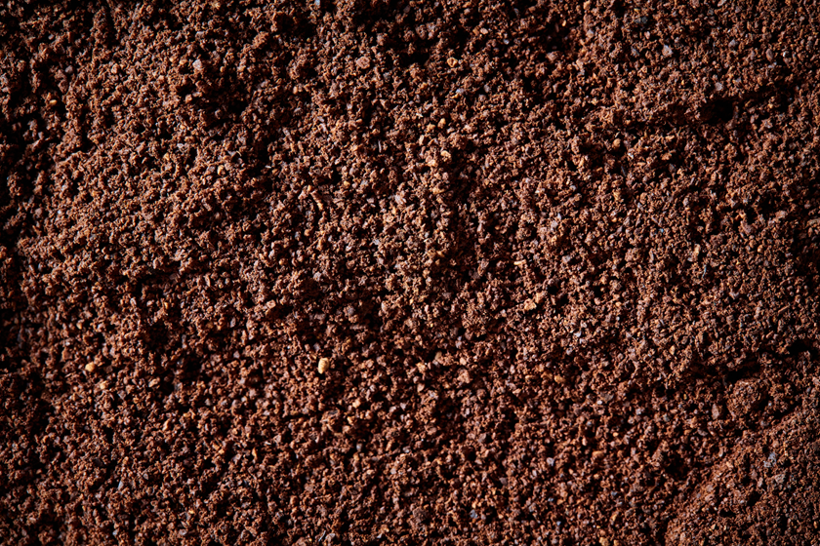
Model Assumptions
Plant pools vary in recalcitrance and decay at different rates
SOM pools differ in chemical quality and decay at different rates

Slide 10


Model Assumptions
Only soil temperature and soil moisture as influencing factors on decay rates
No influence of pH
No inclusion of effect of microbial activity
No influence of N pool and other pools (P, S etc.)

Slide 11
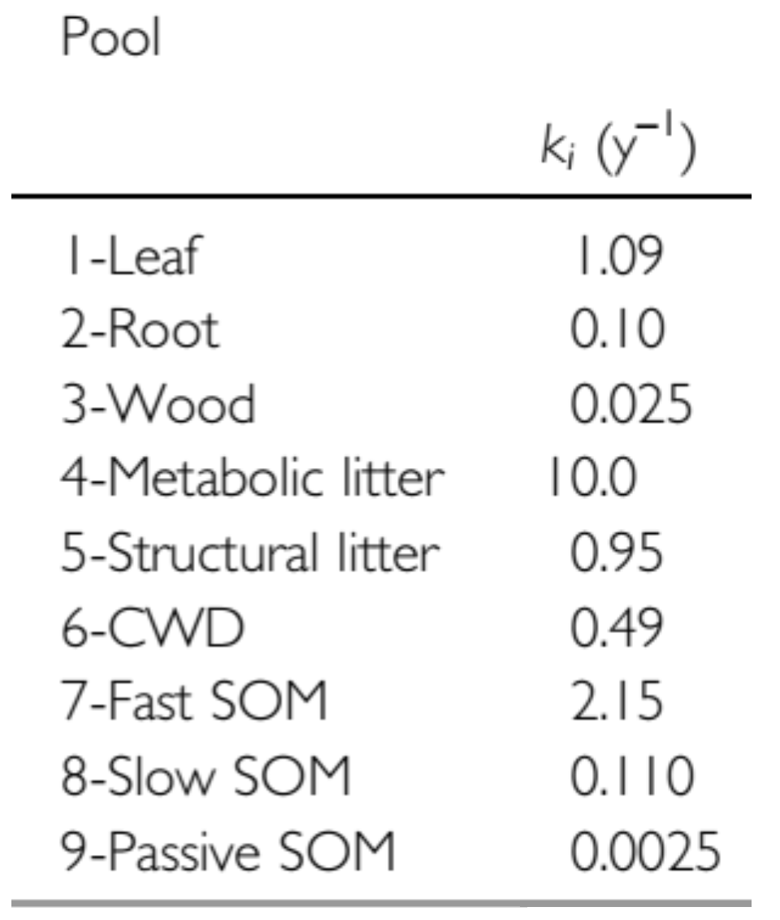
Model Parameters
Decomposition rate constant k → base turnover rate

Slide 12
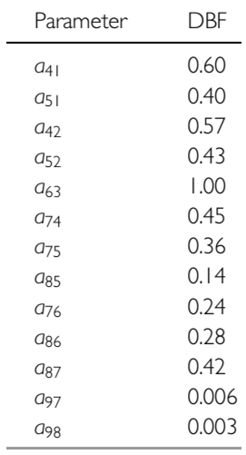
Model Parameters
Carbon transfer parameters → fraction of one carbon pool that enters next carbon pool after heterotrophic respiration loss

Slide 13
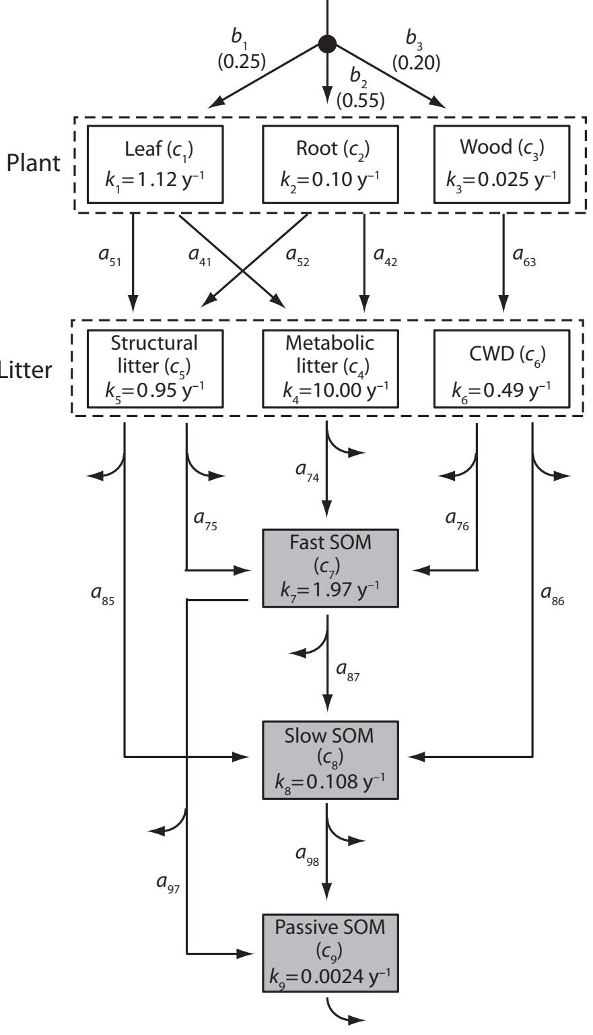
Model Parameters
Carbon transfer parameters → fraction of one carbon pool that enters next carbon pool after heterotrophic respiration loss
CO2
CO2

Slide 14
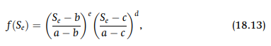
Model Rate Modifier
Temperature function f(T)
Moisture function f(S_{e})

Slide 15
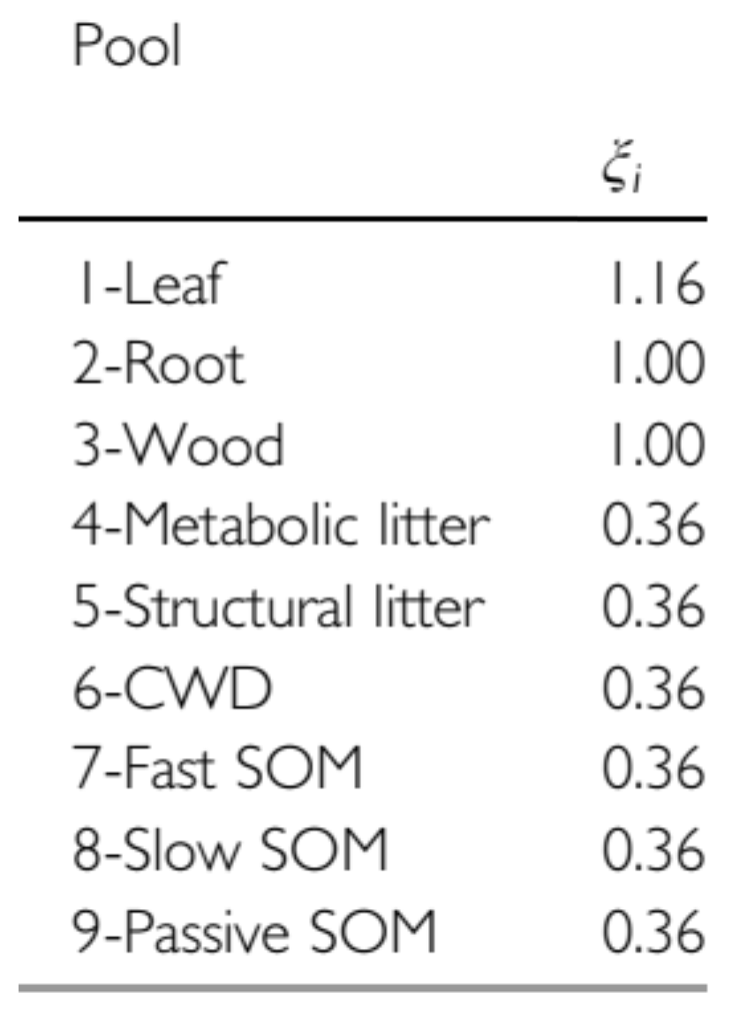
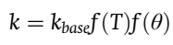
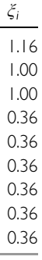
Model Rate Modifier
Soil moisture and soil temperature affect decomposition rate k
Own scaling factors
CASA scaling factors

Slide 16
Our Model
Notes:
Our model practically describes pools, namely our input pools and soil pools, the transfer of Carbon among them, and most importantly, the amount of Carbon respired at each step, which comprise our simulated output of interest. Now I would like to give you some more insight on how we translated this model framework into our script, exemplified by one pool.

Slide 17
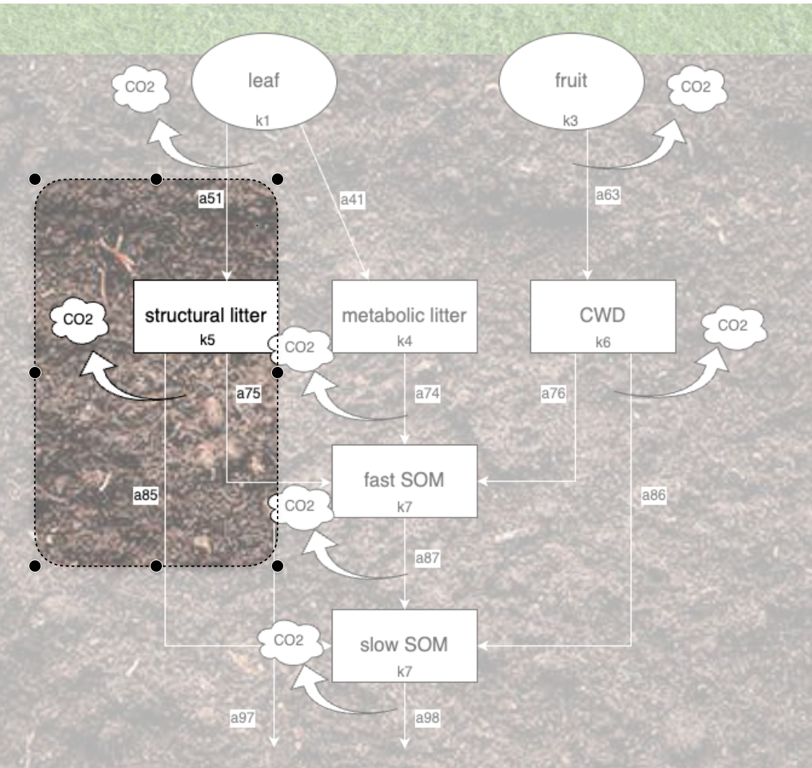
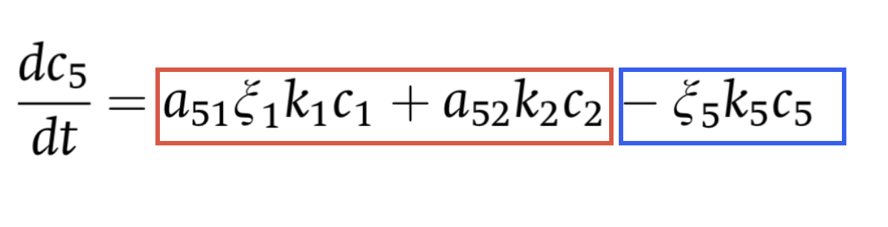
Our Model
Pools
Notes:
On the figure you can see the structural pool and where it is positioned within the model framework. It receives input from the leaf pool, and its output is directed 3-way, towards the fastSOM, slowSOM and of course CO2 is respired.
On the left you see the equation describing this first-order decay of the structural pool, here indicated by C5. The first two terms in red are positive, describing the inputs that the pool receives, while the last term is negative and describes the output for this pool. “a”-s are the transfer parameters, “ksi” are the scaling factors, “k” are the decay rates, and “c” are the pool sizes, all referring to a specific pool.

Slide 18
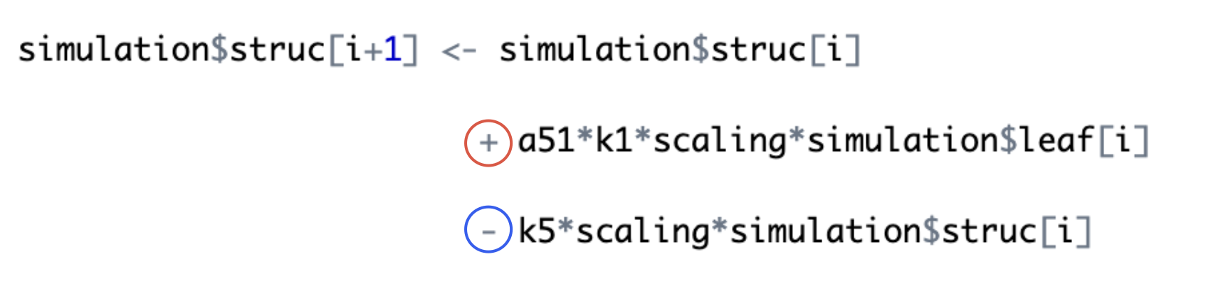
Our Model
Pools
Notes:
Below, you can see the code that describes the same process. Since we did make modifications to the CASA-model, the two equations are not 100% the same. This is part of a for-loop that iterates across our time-frame of two years at an hourly time step. We defined the structural pool starting from the second step only, as in a previous step we already defined the first step, or the initial pool size, by running a 100 year simulation, that Carla will explain in more detail.
On the right side, the first term represents the size of the pool at the previous step, the second positive term is the input to this pool coming from the leaf pool, and the third term is the output of this pool. Here the output represents the entire loss, which constitute the translocated C to other pools as well as the respired C.

Slide 19
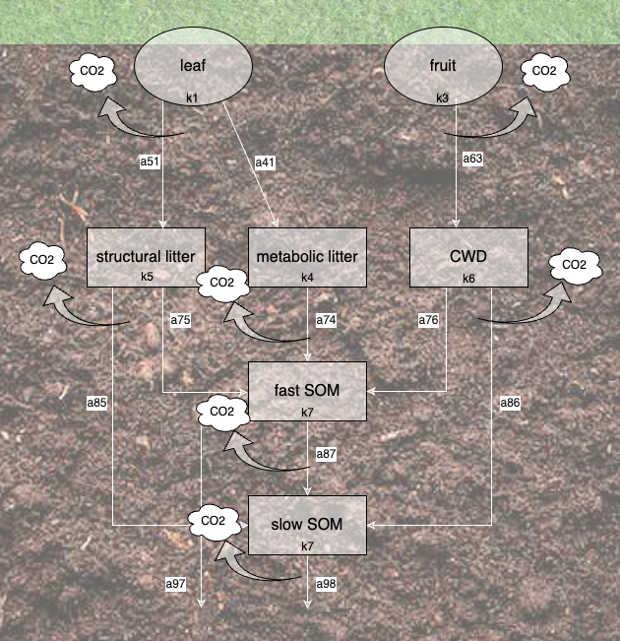
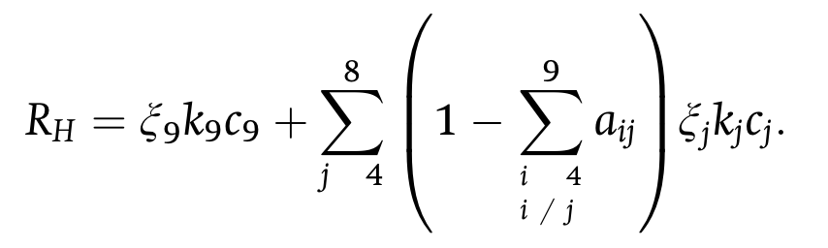
Our Model
Respiration
Notes:
While modelling the pools was a necessary step, essentially our interest was to estimate the total respiration of the system. On the figure you can see that respiration takes place from each pool, and you can imagine that it happens at each hourly step that we modelled.
Bonan described respiration like this, which is virtually a sum of all the respiration from each pool. Since the “a” parameter describes the fraction of the total output that is transferred to another pool, respiration can be expressed as 1- this “a” fraction.

Slide 20
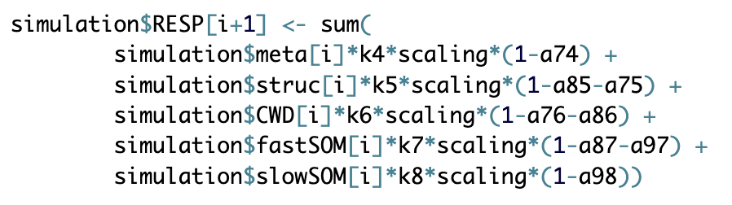
Our Model
Respiration
Notes:
Below you can see how we described this in our script, where at each step the sum is calculated. While some pools translocate C only to a single pool, others may translocate to even two pools. The fraction respired is defined in the last coefficient of each term.

Slide 21
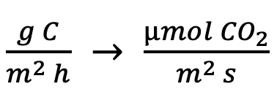
Our Model
Respiration
Unit conversion
* 23.14814815
Notes:
Since all these transformations of C so far had been virtually a fractionation of the original source Carbon, that is the leaf and fruit inputs, our output values for respiration at this point were also expressed in the same unit. So to convert to the conventional unit of respiration, we needed to multiply these values with 23.15.

Slide 22
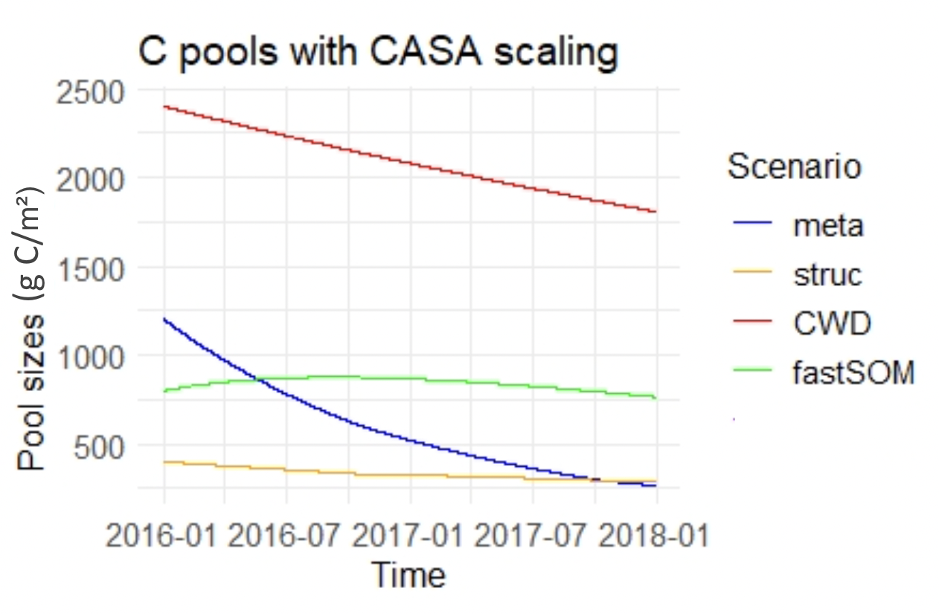
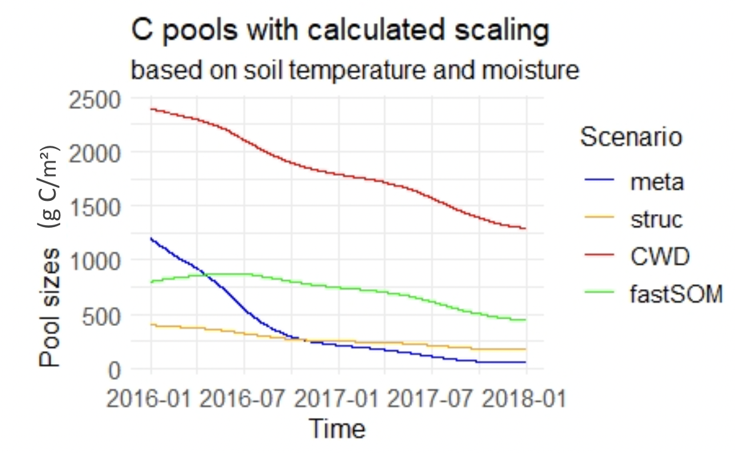
Improving the scaling factor ξ = scaling factor that modifies the turnover rate as an effect of environmental conditions
Notes:
Here you can see how the different pool sizes evolved during the modelled period of 2 years. First we tested the model with the default scaling factor values of the CASA model, that is basically a constant, specific to each pool, that is used to multiple the decay rates. Therefore, you can imagine, that it does not change with time, so using this default scaling factor cannot really represent environmental variability over time.
On the right, you can see how the pools evolved when we applied the scaling factor of temperature and moisture, which Aaron introduced before. These parameters are not constants, but depend on the temperature and moisture that were measured at our site and we had hourly inputs for. Consequently, the model shows greater fluctuation as an effect of its sensitivity to temporal changes of moisture and temperature.

Slide 23

Dynamic equilibrium of SOC stocks To estimate the initial values
Input = mean litterfall
Soil C pool
Notes:
1| To estimate the initial values of our system, we run the our model for loop for 100 years. In case not everybody has done this process, I quickly want to explain the theory, as it can be difficult to understand. If you look at this water bucket being filled with water, which stand for one of our soil Carbon pool, it is clear that the water level will be rising, due to the input.

Slide 24
Dynamic equilibrium of SOC stocks To estimate the initial values
Input = mean litterfall
Equilibrium
Soil C pool
Output = mean turnover + respiration
Notes:
2| However, since we also have an output namely, the turnover rate into different pools and the respiration, the water level will lower again until the output rate is equal to the input rate and therefore crate an equilibrium despite constant changes. This does not mean that the input rate or the output rate are constants in our model and that the equilibrium (the water table) is never changing, just that the average values lead to an approximation of this equilibrium.

Slide 25
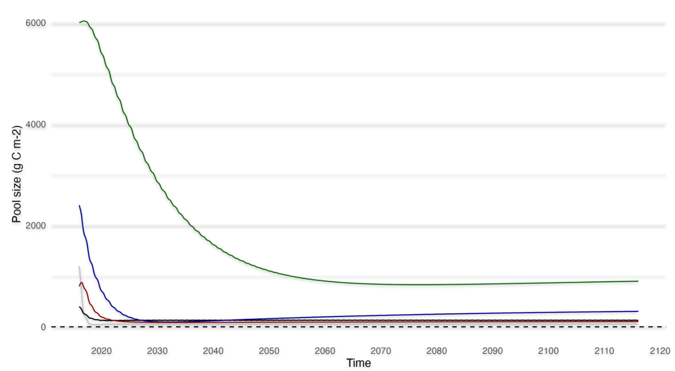
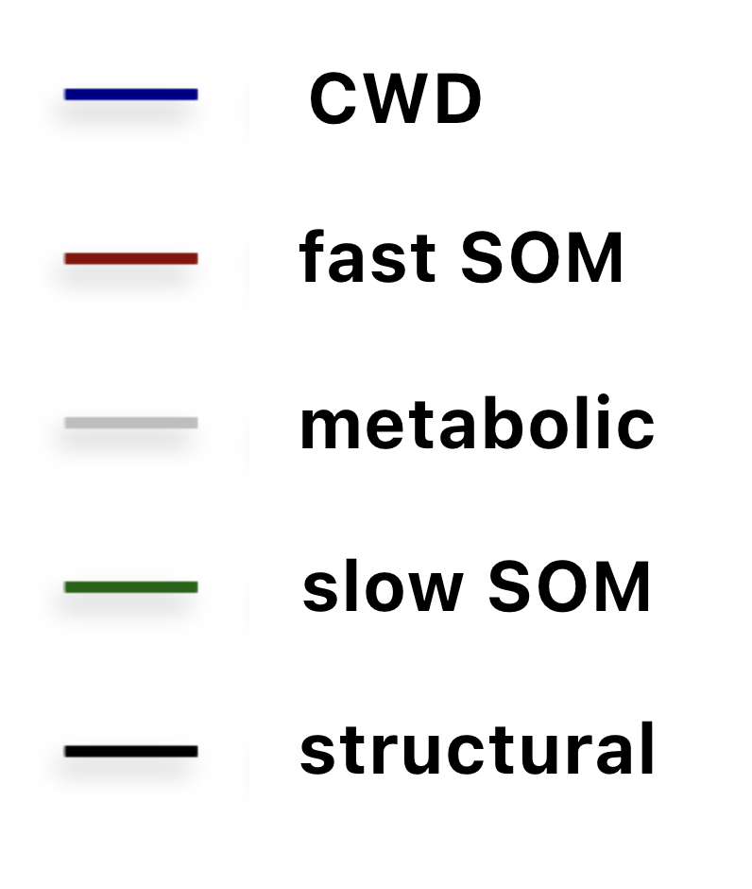
Improving the initial pool sizes Running over 100 years to reach equilibrium
pool | given | modeled
CWD | 2400 | 305.51
fastSOM | 800 | 103.22
metabolic | 1200 | 54.60
slowSOM | 6000 | 899.98
structural | 400 | 129.92
Notes:
3| Lets look at our data: Here you can see how we ran our model for 100 years. As initial values for running this, we used approximate values from previous modeling, that Anne provided for us. However, as you can see they are definitely overestimates in our case.
In the first years all pools are strongly decreasing (meaning the turnover rate is higher than the input). For the fast SOM and the slow SOM you can see that they firstly increase slightly, which is due to the model structure. As other pools output, such as the metabolic litter turnover are respectively the input for the slow and fast SOM.
Here you can also clearly see the reason why we did the calibration of the initial parameters in the first place, as without this, the first two years would show distorted patterns. Nevertheless, you can still see the yearly fluctuations.
However, as you can see the equilibrium is not yet fully reached, although our model run for 7h to reach this, but the slow SOM and the CWD are increasing again in pool size towards the end. This is due to the very slow decomposition rate of the two pools. Therefore it needs much longer to reach equilibrium.

Slide 26
Sensitivity analysis (RMSE)
Identifying factors for the model calibration
 | Scaling factor | Decay rate of metabolic pool | Decay rate of CWD pool
normal | 2.375 | 2.375 | 2.375
x 2 | 2.047 | 2.374 | 2.318
x 0.5 | 2.610 | 2.388 | 2.425
Notes:
4| After the initial values, we also tried to improve some parameters, therefore we did a manual sensitivity analysis based on the RSME. We chose the scaling factor, the decay rate of the metabolic pool, as it has one of the fastest turnover rates and the CWD, as it is the largest pool after slowSOM, however, SlowSOM is too slow to matter on our 2 year timescale.
We then multiplied all these rates with 2 and 0.5 respectively, and checked for the strongest change in RMSE.
As you can see this is the scaling factor so in the following we focused on improving it.

Slide 27
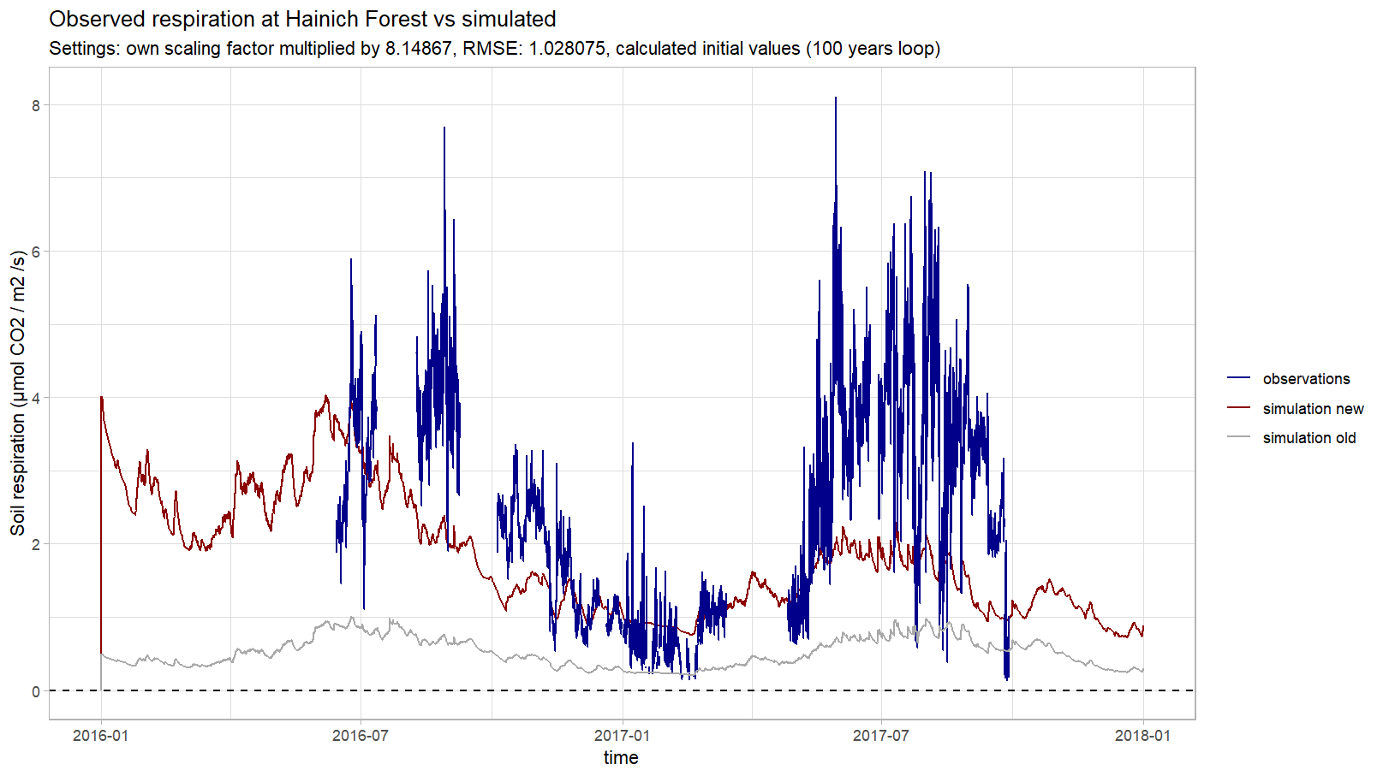
Model calibration
Using the Nelder-Mead method
Notes:
5| To calibrate the scaling factor we used the build-in R function for the Nelder-Mead-method, which resulted in an increase of the scaling factor by 8! You can see here in the red line our improved function, which clearly has a better model fit than the previous function, however it still is underestimating the measured values (blue line), especially in the warm months and fall. Potential reasons for that will be explained by Favour later on.

Slide 28

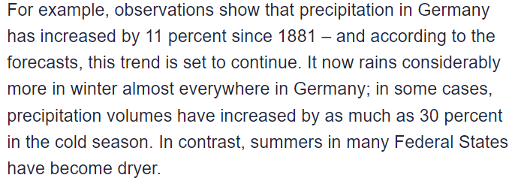
Climate change in Germany?
(Ute Kehse, 2017)

Slide 29
Modelled climate change scenarios
Scenario 1
Temperature - increase by 2°C (similar to RCP4.5)
Moisture - 20% decrease in summer & spring, 10% increase in winter & fall
Scenario 2
Temperature - increase by 4°C (similar to RCP8.5)
Moisture - 40% decrease in summer & spring, 20% increase in winter & fall
Notes:
We can also show what happens to decomposition rate if temperature or moisture increases?
Talk about climate change scenario
Talk about how soil carbon is a very important pool when it comes to the carbon cycle.

Slide 30
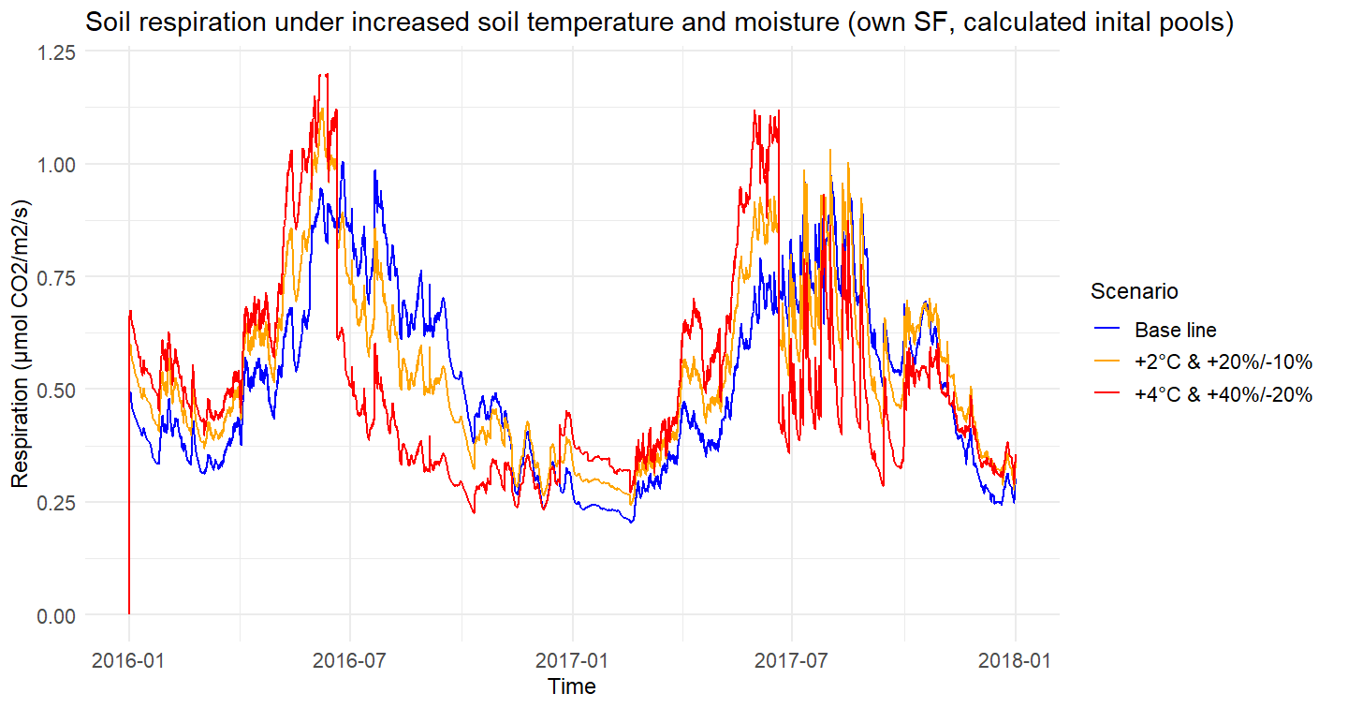

Slide 31
Possible Improvements
Actual parameters for fruit pool
Root respiration is an important part of respiration
Many other abiotic factors influence soil respiration
Microbial activity is not explicitly represented in biogeochemical models
Longer reference period (more than 2 years)
Accurate respiration measurements

Slide 32
References
Bonan, G. (2019). Climate change and terrestrial ecosystem modeling. Cambridge University Press.​ Chapters 4, 17 and 18.
Nemoto, R. (2013). Soil organic carbon (SOC) now and in the future. Effect of soil characteristics and agricultural management on SOC and model initialisation methods using recent SOC data. https://tel.archives-ouvertes.fr/tel-00973853
Xu, H., Zhang, T., Luo, Y., Xin, H., & Xue, W. (2018). Parameter calibration in global soil carbon models using surrogate-based optimization. Geoscientific Model Development, 11(7), 3027–3044. https://doi.org/10.5194/gmd-11-3027-2018.
https://phys.org/news/2017-03-climate-affecting-germany.html
https://www.umweltbundesamt.de/daten/klima/trends-der-niederschlagshoehe

Slide 33

Thank you for your attention!
Are there any questions?

